Slide 1
Why does harm occur?
Notes:
Welcome to Module 2, Snippet 1 of Safe System for Universities. In this snippet, we will discuss some of the reasons why harm from road crashes occurs, and some common mistakes that are made when attributing reason to the causes of harm.

Slide 2
Press enter to continue
1.0
01 Jul 2020
Module 2, Snippet 1

Slide 3
About this snippet
This snippet is made up of a number of sections. Click on the below links to go through each section. To advance a slide, press enter on your keyboard or click the slide.
Start here
Go to Kimber’s model
Go to Why does harm occur?
Go to Reason’s model
Notes:
This snippet is made up of a number of sections. Click on the below links to go through each section. To advance a slide, press enter on your keyboard or click the slide. If you miss anything that has been said, you can replay the narration to each slide. A printed version of the narrative is also provided in the curriculum guideline.

Slide 4
Why does harm occur?
Notes:
Firstly, let’s take a look at the mechanisms that can cause harm to road users.

Slide 5
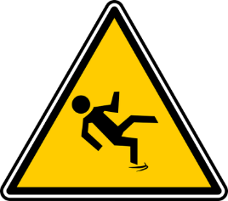
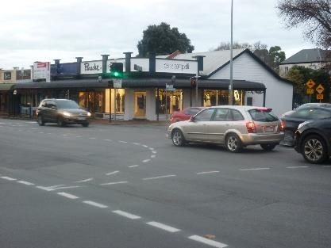
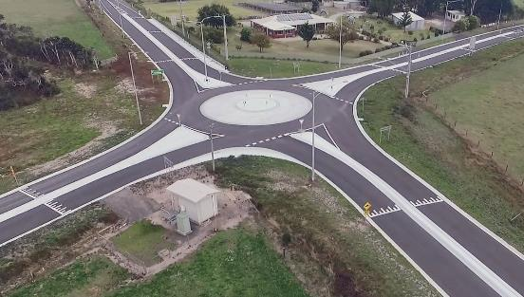
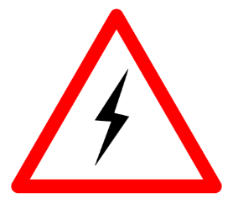
Mechanisms of harm
Press enter to continue
Physical
Chemical
Biological
Electrical
Source: Centre for Automotive Safety Research
Source: Regional Roads Victoria
Notes:
There are a number of ways harm can occur. Harm could occur from physical, chemical, biological, electrical or a number of other mechanisms. Physical harm is a common mechanism within the road transport industry, and so we will focus on this.
There are two general mechanisms that lead to harm, latent conditions and active failures. Active failures are the errors and mistakes made just prior to a crash. These failures are generally made by road users. Some examples of active failures are a pedestrian choosing to cross the road when a vehicle is approaching; a driver taking a curve along a road at too high a speed; and a driver picking an inadequate gap in traffic when turning at an intersection.
Latent conditions are the other mechanism of harm. Latent conditions can occur at any time and may lay dormant in the system for many years before the circumstances are ripe for failure. Latent conditions can be from recognisable errors, such as building a road below the recognised design standards. Latent conditions can also be hidden in plain sight. A good example are intersections. Many intersections contain the latent conditions that can foreseeably turn a simple mistake made by a road user into a harmful crash. Some intersection designs, such as many roundabouts, remove or reduce these latent conditions by controlling the speeds and angles at which vehicles can interact.

Slide 6
Kinetic energy management model
Press enter to continue
Layer 4: risk of energy generation
Layer 2: the transfer of kinetic energy to the user
The user must be protected from harm
Layer 1: the human biomechanical tolerance to harm
Layer 3: the kinetic energy generated
Layer 5: exposure to energy sources
Source: based on Corben et al (2010)
Notes:
The kinetic energy management model, or Kemm, was developed to demonstrate the way in which road users can be exposed to kinetic energy, which is the cause of physical harm. At the centre of the kinetic energy management model is the human body, which is vulnerable to physical harm.
Radiating out from the central human body are the five layers of energy transfer that can allow a person to be harmed, or if considered appropriately, stop the harm from occurring. The first three layers deal with the consequences of a crash through the generation and transfer of kinetic energy that results from a crash. The fourth layer deals with the likelihood of a crash should road users be exposed to the conditions that could lead to a crash. The fifth and final layer deals with the exposure of road users to situations where crashes can occur.
Every layer within the model represents an ability to protect road users from harm. Traditionally, we have been very good at dealing with the fourth layer, the likelihood of a crash, to offset effects of exposure. In other words, we have managed to reduce the frequency at which crashes occur, even with an ever increasing demand to use the road system. However, we know that crashes will not be completely eliminated. Even with the very small likelihood of being involved in a crash that each person faces, the sheer number of people using the road system ensures that some crashes will occur.
So how can we protect those road users who ultimately end up being involved in a crash? This is where the first three layers of the kinetic energy management model come into play. Historically, we have been rather poor at dealing with the consequences of crashes. However, the model helps to demonstrates the substantial contribution that consequence can play in deciding the harm that road users are exposed to. It also demonstrates the methods that can be used to protect road users from severe consequences, such as through reducing the energy generated in a crash or reducing the transfer of energy to the road users.

Slide 7
Reason’s model
Notes:
We first visited Reason’s swiss cheese model of failure trajectory in Module 1, Snippet 3 of the Safe System for universities. Now, we will look at this model in the context of our road transportation system.

Slide 8
Reason’s Swiss cheese model
Press enter to continue
Each layer forms a barrier to harm
Gaps in each layer lead to harm
Focus on user behaviour limits ability to eliminate harm
System decision makers
Preconditions
Defences
Source: Based on Reason (1990)
Productive activities
Line management
Notes:
James Reason’s swiss cheese model a well known example of failure trajectory. In it, barriers to failure are represented as layers through which the failure trajectory must navigate.
Holes in these layers, which represent latent conditions and subsequent errors, must align in the right place and at the right time for a failure to occur. In other words, a window of opportunity forms through which the failure trajectory can traverse.
When the holes in the layers do not align, the failure cannot occur. Much like a person walking through a succession of doors to reach a destination, it only takes one locked door in order to prevent the person from reaching their destination. Like this analogy, it only takes one layer to form a barrier for failure to be prevented. It is important to note that holes within one layer can circumvent the effects of other layers. For example, policy implemented by system decision makers may be weakened if it is not implemented properly by line management, or followed by system users.

Slide 9
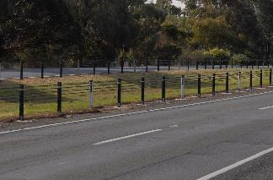
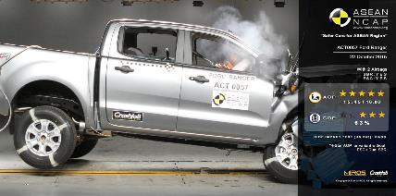
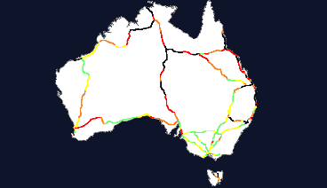
Reason’s Swiss cheese model
Press enter to continue
Road Safety Strategy 2020-2030
System decision makers
Preconditions
Defences
Source: Centre for Automotive Safety Research
Source: This Photo by Unknown Author is licensed under CC BY-NC-ND
Productive activities
Line management
Source: Centre for Automotive Safety Research
Source: adapted from AusRAP (2016)
Notes:
As a society, we have become very good at focussing on the role of road users in crashes and the failures that they have made, which contributed to the outcomes. While road users certainly contribute to the occurrence of crashes, such a focus draws attention away from the other factors that contribute to crashes and the more manageable aspects of the road transport system that we, as system managers, can influence to reduce the harm that occurs on our roads.
The highest level of intervention that senior system managers can make is commonly through the strategic decisions and policies. Through these strategies and policies, senior system managers can guide the way in which the system is managed and target directions that have a greater focus on reducing and ultimately eliminating harm from our road network. A commonly seen example are the road safety strategies used nationally and by each state to outline their strategic direction in reducing harm from road crashes.
Line managers can also play a role in the reduction and elimination of harm. This can be done by actively considering the potential for harm that is generated through day to day activities. A good example is the proactive consideration of the risk of harm. Proactive risk tools, such as road assessment programs, can be used by line managers to identify where higher levels of risk exist on the road network and use this information to justify the need for funding and prioritise works that have a greater ability to improve road safety.
The preconditions of failure can be influenced by system managers by implementing design and operation of the road network that reduces the risk of harm. For example, this could mean selecting speed limits and managing speeds that are appropriate for the type of road environment. System users can also affect the preconditions, such as by choosing to drive a safer model of vehicle, such as an Ancap five star rated vehicle. Here too, system managers can have an influence by imposing and motivating the use of safer vehicles, such as through the release of safety rating information to influence buyers and fleet purchasing policies that ensure only the safest vehicles will be purchased for fleet use.
Lastly, system managers can affect the defences that safeguard from harm. For example, this could be through ensuring that forgiving roadside and centreline barriers are installed along roads where high speed run off road and head on crashes can occur. System users can also contribute by using vehicles with advanced safety technologies that can help prevent crashes or cushion themselves and others in the event of a crash.

Slide 10
Kimber’s model
Notes:
Kimber’s model aims to highlight the different factors that contribute to crashes. We will now take a look at the relative contribution of crash mechanisms through the lens of this model.

Slide 11
Kimber’s model of crash contribution
Press enter to continue
Conceptual model: classification of crash causation
Driver
Vehicle
Road
Mode of failure
Crashes with more than one identified mode of failure
Source: based on Kimber (2005)
Notes:
Kimber’s model is used to describe the contributions of different factors in the causation of road crashes. The model is shown as a Venn diagram of failure modes in which a single factor is deemed responsible, as represented by the non-overlapping areas of the circles, and of failure modes in which more than one factor is deemed responsible, as represented by the overlapping portions of the circles.
As shown here, the model represents three factors commonly associated with road crashes. These are the driver that is in control of a vehicle, the road environment on which a vehicle is being driven, which includes the speed limit along the road, and the vehicle that is being driven. This model as we see it here identifies the relationships between the different factors, but does not attribute the magnitude of contribution by each factor.

Slide 12
Kimber’s model of relative contribution
Press enter to continue
Relative contribution
Conceptual model: classification of crash causation
Driver
Vehicle
Question: In this sense, the model is correct. But of what use is it?
Question: Driver error is very often a contributing factor, but is rarely the only factor.
Road
Mode of failure
Crashes with more than one identified mode of failure
Source: based on Kimber (2005)
Notes:
If we consider the relative contribution of each factor, we can see that driver error contributes to most crashes, while road and vehicle failures, such as reduced pavement friction or defective brakes, contribute to a lesser proportion of crashes. In this sense, the model is correct, but of what use? In short, its use is limited when an important omission within this model is considered. This model give no consideration to the latent conditions that ultimately lead road users to make the errors that contribute to most crashes.

Slide 13
Kimber’s revised model of contribution
Press enter to continue
Kimber’s idea of a more appropriate model
System failures
(driver / vehicle / road)
Crashes are due to multiple factors
Well trained, compliant drivers routinely make errors
Where road/vehicle circumstances allow, errors can translate to harm
Driver failure: Excessive non-compliance
Driver failure: Inexperience
Source: based on Kimber (2005)
Notes:
A more appropriate model is that of Kimber’s revised model, which draws a perspective on system failures, rather than isolating human error. In this form of the model, we can also appreciate the contributions of error provoking conditions. Seen through this perspective, we can now see that system failures, which stem from both system deficiencies and error provoking conditions, are responsible for the vast majority of crashes. Human error in isolation is responsible for only a small number of crashes, which generally involve either extreme non-compliance or inexperience.
We can now see that system failures, as shown here, represent the multitude of latent conditions and active errors that lead to a crash. The benefit of this perspective is to take focus away from just the contribution of error made by the driver. When we draw focus to the system perspective, we can see that driver error is just one link in a chain of actions that led to a crash. Take any of these links away, and the crash would not occur in the first place. This then begs the question, is driver error really to blame when it was weaknesses within the system that allowed error to translate to a crash?
While Kimber’s model was created specifically to demonstrate the fallibility of focusing solely on human error in finding the causes for car crashes, it can be applied equally as well to many other industries. The point of the model is to demonstrate that the entire system, comprising latent conditions as well as active errors, contributes to failures. By looking at the entire system, instead of focusing on one small part of it, we are able to better understand the conditions that lead to failures and employ more diverse solutions for mitigating their damaging results.

Slide 14
Module 2, Snippet 1

