Slide 1
What is a Safe System?
Notes:
Welcome to Module 2, Snippet 3 of Safe System for Universities. In this snippet, we will unpack the concept of the Safe System and look at what it means for those who are ultimately responsible for the safety of road users, the system managers.

Slide 2
Press enter to continue
1.0
01 Jul 2020

Slide 3
About this snippet
This snippet is made up of a number of sections. Click on the below links to go through each section. To advance a slide, press enter on your keyboard or click the slide.
Start here
Go to A manager’s responsibility
Go to Harm elimination
Go to System perspective
Go to The Safe System
Notes:
This snippet is made up of a number of sections. Click on the below links to go through each section. To advance a slide, press enter on your keyboard or click the slide. If you miss anything that has been said, you can replay the narration to each slide. A printed version of the narrative is also provided in the curriculum guideline.

Slide 4
Harm elimination
Notes:
An ethical imperative of eliminating harm forms the basis on which the Safe System stands. We will start by taking a look at what harm elimination means in the context of how we approach the management of a road transportation system.

Slide 5
Harm comes from errors
Press enter to continue
Errors
Tolerance
Harm
Whenever and where ever people have access to a system, errors will occur
Errors cannot be eliminated unless people are removed from all aspects of the system
The human body has a finite tolerance to harm
Harm occurs once the biomechanical tolerance to force is exceeded
Use of the system should never result in harm
Even when errors occur, the system should protect the user from harm
Module 2, Snippet 3
5
Notes:
Errors are a normal part of life. We expect them to occur in almost everything we do. People do not perform at a one hundred percent level, one hundred percent of the time. This means that whenever and where ever people have access to a system, errors will occur. The road transportation system is no exception, and while we have become very good at reducing the likelihood of errors, it is clear that a certain amount will continue to occur. Unless we remove people from all aspects of control or input into the road transportation system, errors will be unavoidable.
When errors occur, they can result in crashes that have the potential to cause harm. Most errors will not result in a crash, and most crashes that do occur will not result in severe injury. This is because the human body has a certain tolerance to physical harm before it breaks. With the developments that have been made on our roads and by the vehicles that we drive, the chances of exceeding this tolerance have been reduced over time. However, exceeding this tolerance is still a distinct possibility for a substantial portion of travel that people undertake within our road transportation system.
Because of the sheer number of people using our road transportation system, even a minute possibility for a single person to be involved in a severe crash translates to a substantial amount of harm that is being done to people. As discussed in Snippet 2 of this module, the ethical imperative that underlines the Safe System calls for no person to be fatally or seriously injured as a result of using our road transportation system. While errors will continue to occur and some of these errors with continue to result in crashes, a Safe System means that harm should not result.

Slide 6
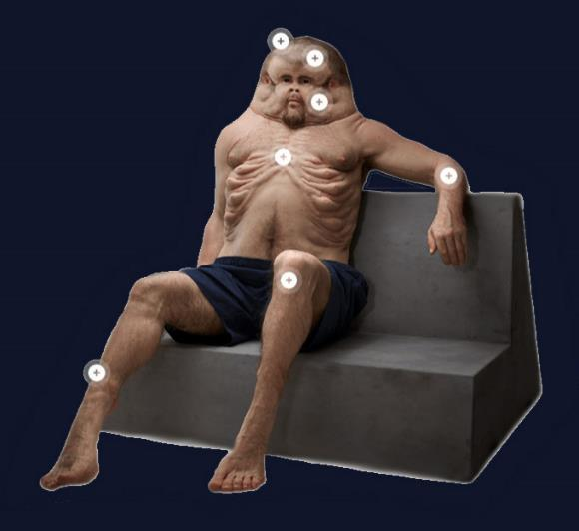
Meet Graham
Press enter to continue
Graham represents the human body evolved to cope with forces associated with use of our modern road transportation system
Evolved to survive a car crash
Did not evolved to survive a car crash
Source: iStock.com
Source: Transport Accident Commission of Victoria
Module 2, Snippet 3
6
Notes:
Meet Graham, he is a collaborative creation funded by the Transport Accident Commission of Victoria. Graham represents what the human body could look like if it had evolved to cope with the forces associated with the use of our modern road transportation system. In other words, Graham evolved to survive a crash that other humans would not be able to survive. Unfortunately, the road transportation system is a relatively new concept and humans have not been able to evolve alongside it. Graham is a good reminder that we are not built to cope with the magnitude of forces associated with road use.
Humans did not evolve to survive a crash. Despite this, we have inherited a road transport system that is not very good at considering this limitation. Moving forward, we will need to become better at considering human limitations within our design and operation of the road transportation system. In other words, design and operation will need to shift from a car-centric position to a human-centric position. Road transportation will need to continue to be realigned to the human scale.

Slide 7
System perspective
Notes:
Harm elimination has its best chance when the road transport system is approached from a system perspective. Now, Let’s take a look at how this changes our approach to road safety.

Slide 8
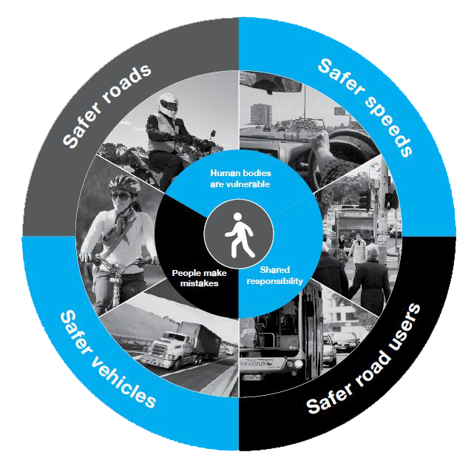
System perspective
Press enter to continue
The system is represented by pillars
Each pillar strengthened to multiply effects
All pillars contribute to harm elimination
Source: Victoria State Government (2016)
Module 2, Snippet 3
8
Notes:
The Safe System is generally represented as a system of individual pillars. Each pillar represents a different aspect of the system and within each of these pillars are considered the ability for failures to occur and the possibilities to prevent these failures from translating to harm. The notion of these pillars has come from the tendency for questions and answers to the problem of road safety to be related only to the road user. The addition of further pillars represents the ability to question issues and seek answers within other areas of the road transportation system, especially those in which system managers hold responsibility.
Historically, we have heavily relied on drawing solutions from road users and not from the system in which they perform, limiting our ability to solve problems. The Safe System changes this mentality by explicitly focussing on the entire system and drawing solutions from every pillar. The strength of the Safe System lies in the ability to draw solutions from multiple pillars, thereby creating redundancy to counter the effects of failure in one pillar by placing strength in another pillar.
As an example, picture a rural road providing a link between regional centres. Developments in vehicle technologies provide safer vehicles for those using the route, while enforcement activities help to ensure road users remain compliant. The road itself provides solutions to improve the performance of road users driving along the route, through features such as audio tactile line marking to make drivers aware when they drift out of their lane, and sealed shoulders to provide extra space in which to correct their path of travel. At the same time, the surrounding environment takes into consideration the fallibility of road users by limiting speed limits to within safe levels and providing features such as road safety barriers to control the outcomes of crashes when they do occur.

Slide 9
System response
Press enter to continue
Safe road users act within prescribed limits
Safe roads guide and protect users
Safe speeds reduce energy in a crash
Safe vehicles protect occupants in a crash
Source: Victoria State Government (2016)
Module 2, Snippet 3
9
Notes:
The four pillars of the Safe System represent four distinctly different aspects of the system. Firstly, road users are compliant and act within reasonable boundaries. Enforcement and education are used to maintain these boundaries. Extreme violations such as extreme speeding and drink driving are not tolerated, but errors are expected and lapses in judgement, such as low-level speeding, are tolerated.
Roads and the roadside environment are designed and operated to protect users. Road and roadside treatments such as sealed shoulders and road safety barriers are used to reduce the likelihood of crashes and prevent severe outcomes in the case that crashes do occur. Intersections are designed to reduce exposure to other vehicles and reduce confusing situations that could lead to error. At the same time, intersections are designed to ensure that vehicles cannot collide in configurations and at speeds where severe outcomes can be expected. All road users are protected and those that are more vulnerable, such as cyclists and pedestrians, are afforded additional protection and given their own areas of priority over the network. Finally, incompatible situations are eliminated as far as is possible, such as interactions between cyclists and heavy vehicles.
Speed is a key element of the Safe System. Where road design and vehicle technology cannot ensure safe interactions between road users and the surrounding environment, speeds are limited to ensure the human biomechanical tolerance to harm is not exceeded in a crash. Speed is also managed to reduce the likelihood of crashes occurring in the first place. Elements of education and enforcement are used to maintain speeds to within acceptable levels.
Vehicles arguably represent the area of greatest improvement in road safety over the past decades and will likely hold a key place within the system. Vehicle technology acts to reduce road user error and correct driver actions when errors are made. Technologies also improve the outcomes of crashes when they occur. Education, policy and legislation are used to improve the uptake of safety technology and motivate the use of safer vehicles, especially among government and commercial fleets.

Slide 10
A manager’s responsibility
Notes:
Next, let’s discuss how the Safe System impacts upon the role of system managers and their responsibility towards road users.

Slide 11
Shared responsibility
Press enter to continue
System managers’ responsibility to implement and maintain a system that does not knowingly introduce risk of harm to the system users
System is revised
System is used
System managers’ responsibility to alter the system when system users continue to be harmed from ongoing errors or non-conformity
The system users’ responsibility to use the system in accordance with its design that does not knowingly introduce a risk of harm
Risk identified
Notes:
Shared responsibility is an idea upon which the Safe System philosophy of road safety is predicated. At the core of the Safe System is the concept of maintaining a system free of harm, with responsibility for obtaining this shared between managers and users of the road system.
Firstly, it is the system managers’ responsibility to implement and maintain a system that does not knowingly introduce an unacceptable level of harm onto system users. In the realm of road safety, an unacceptable level of harm has been identified as death or serious injury. Any lesser level of harm is undesirable, but ultimately accepted as a possibility as it is understood that with currently knowledge, eliminating all levels of harm is unachievable.
It is then the system users’ responsibility to use the system in accordance with its design and to not knowingly introduce additional risk of harm through their own actions. This is where the idea of shared responsibility can break down as the question often arises: what if a risk of harm is identified that has been caused by inappropriate behaviour on the part of the system users?
Ideally, the answer to this question is that it is always the responsibility of the system managers to maintain a system free from harm, no matter how that harm may arise. In other words, the system should be designed so that users cannot act in such a way that introduces additional risk of harm. In practice, however, this can be a challenge and is an area of much debate. Nonetheless, such debate should not prevent system managers from taking responsibility and acting on foreseeable risks of harm to the best of their abilities.

Slide 12
Duty of care
Press enter to continue
System managers’ responsibility to implement and maintain a system that does not knowingly introduce risk of harm to the system users
System is revised
System is used
System managers’ responsibility to alter the system when system users continue to be harmed from ongoing errors or non-conformity
The system users’ responsibility to use the system in accordance with its design that does not knowingly introduce a risk of harm
Risk identified
Notes:
Duty of care is a concept closely aligned to that of shared responsibility. While a system manager’s duty of care is arguably intrinsic in all steps in this cycle, it is when a previously unforeseen risk is identified that the ethical dilemma can become complicated.
While risks that are identified in the system can be due to oversight on the part of the system designers and operators, they often include an aspect of system use that deviates from expectation. Because these deviations of use usually lead to the active errors that result in failure, it is easy to attribute causation of failure to the system users. This is especially the case when system use that results in a failure has been in extreme violation of the rules and expected behaviour of system users.
This attribution of blame to the system user can lead to a breakdown in the duty of care that lies with system managers. The question can often arise: shouldn’t the system users change their behaviour to conform to the system? While this approach may be favoured by some, it is ultimately fraught – behavioural change is one of the hardest things to accomplish. This means that changing the system to conform to user behaviour is often the most viable action. The responsibility to action such change forms part of the duty of care.

Slide 13
The Safe System
Notes:
Formed on the basis of an ethical imperative of eliminating harm, the Safe System is a philosophy for our approach to road safety. Let’s look at what this philosophy means in practice for those managing our road transportation system.

Slide 14
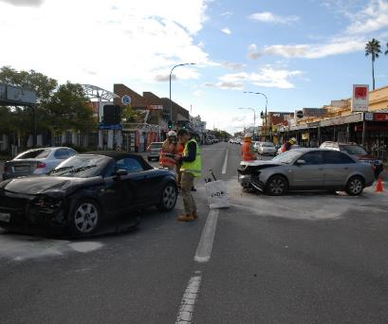
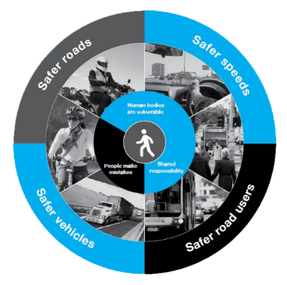
What is a Safe System?
Press enter to continue
Source: Centre for Automotive Safety Research
Source: Transport Accident Commission of Victoria
Source: Victoria State Government (2016)
Errors will occur
The human body has a limited tolerance to harm
shared responsibility led by system managers
Module 2, Snippet 3
14
Notes:
As discussed in the previous snippet, the Safe System starts with the ethical imperative that people should not be harmed as a result of using the road transportation system. As we have discussed here, the Safe System is underpinned by the notion that people make mistakes and that no amount of education, enforcement or design will be able to prevent all error from occurring. There is therefore a need to also manage the consequences of crashes when they occur, to ensure that fatal and serious injuries do not result. While much progress has been made in protecting road users from harm, we still design and operate the road system without much consideration to the consequences of crashes.
People are harmed in crashes when their biomechanical tolerance to harm is exceeded. In other words, physical forces on the body exceed what it is able to withstand before breaking. This is a key consideration that must be accounted for in the design and operation of the road transportation system, if harm is to be eliminated. A widespread example of how this is not currently being achieved is that of signalised intersections. Signalised intersections are operated on high volume roads with speed limits generally in excess of fifty kilometres an hour. We know that at a fifty kilometres an hour impact between two vehicles travelling on adjacent roads, there is a small but real chance that a fatal or serious injury will occur. As speed increases, the chances of fatal or serious injuries rapidly increases.
Central to the Safe System is the idea of shared responsibility. It is the responsibility of both road users and system managers to ensure harm does not become a result of system use. While road users hold responsibility for their own actions and are expected to remain compliant with no extreme violations, the responsibility for ensuring survivability is ultimately led by the system managers that design and operate the road transportation system. It is the system managers’ responsibility to ensure that all reasonable steps are taken to ensure harm does not occur and if it does occur, to ensure steps are taken to rectify the gap that allowed such a failure to occur. This is a system manager’s duty of care.

Slide 15
Prioritising safety
Press enter to continue
Balancing act between Safety and Mobility
Safety as a non-negotiable (Mobility a function of safety)
Focus on eliminating harm
Design to tolerate errors
Management of kinetic energy
Systems perspective
Module 2, Snippet 3
15
Notes:
Transitioning to a Safe System means that the way we approach management of the road transportation system will need to change. Traditionally, safety and mobility form part of a multi-criteria approach where both can be traded off against one another in a quest to find an optimal balance in the benefit to each criterion. While this approach aims to increase safety, it does not place a limitation on the minimal level of safety that will be accepted. The result of this can be seen all around our road network, with fatal and serious injuries being an all too common result of system use.
Under the Safe System, this approach is reversed to one where safety becomes a non-negotiable and mobility becomes a function of safety. In practice, this will mean that while safety is an integral part of an multi-criteria analysis, there exists a minimum level of safety beyond which any proposal, no matter how optimal for any of the other criteria, is rejected. In other words, mobility and other functions of the road transport system can be optimised within the boundary of no foreseeable fatal or serious injuries.
What this all means for system managers is a need to ensure roads are designed and operated to tolerate normal human performance and the errors that can be foreseeably expected. Kinetic energy around the road network must therefore be managed to ensure the energy generated during a crash and transferred to the people involved is not above the human biomechanical tolerance to harm. This essentially means that roads must be designed to separate or insulate people from harmful levels of energy, or speeds must be lowered to more tolerable levels. To do this, we will need to focus on the whole system and what each element can lend in the quest for harm elimination, rather than a single focus or approach on any one element.

